Slide 1



Train Dispatch: Presentation
Christopher Lindelof
Gengbo Liu
Eric Larochelle

Slide 2
Project Objectives
Write a Base-Case Train Dispatch System, and proceed to beat the implementation with an Optimized-Case
To Create, Organize, and Efficiently Manage Time

Slide 3
Base-Case vs Optimized-Case
Base-Case : Locks Tracks
  The Base-Case locks tracks for the full time between start and end stations
Optimized-Case : Inteligiently Locks & Unlocks Tracks
  The Optimized-Case only locks the track that is being traversed, allowing for the previous or future segments of track to be utilized.

Slide 4
Data Structures
ArrayLists
  used for O(1) access
  used when adding to list was at the end
  used when list was not to be sorted
LinkedLists
  used when adding to list at the i-th index
  used when sorting frequently

Slide 5
Optimized-Case Data Structures
HashMap
  used to optimize path finding
  used to reduce space complexity

Slide 6
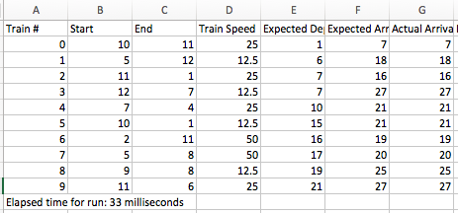
Optimized-Case Output

Slide 7
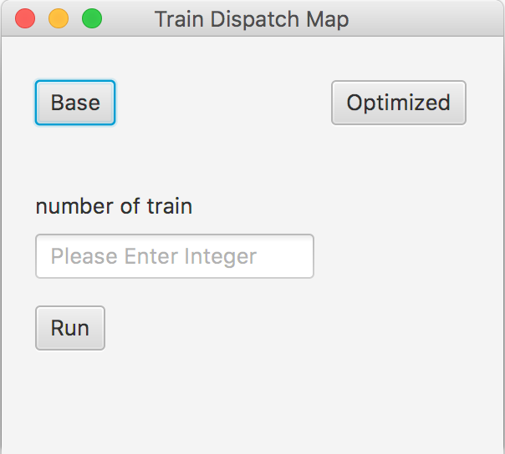
User Interface
Implemented through Gui.java
Allows user to select number of trains, as well as which case they would like to run

Slide 8
Demo
< Run User Interface>

Slide 9
Space complexity
No more track objects than the actual number of tracks
Trains keep track of the track (reference), and the lock time they have been granted.

Slide 10
Time
Graph is weighted to represent kilometers
Trains have 1 of 3 speeds
Time for traversal is calculated
  Rounded up to next, integer value

Slide 11
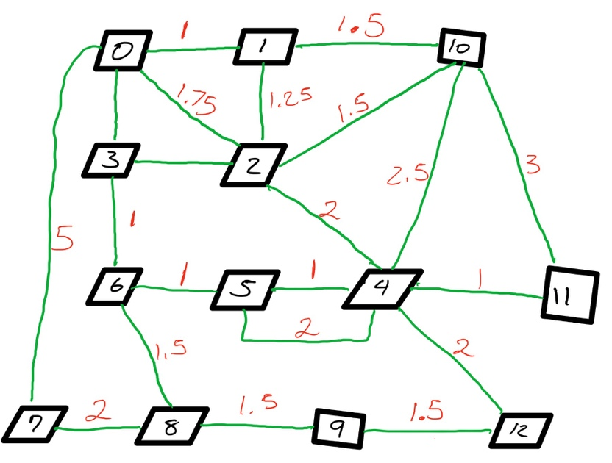
Time
Map is fed to program in weights of 1/50th of the final track weight

Slide 12

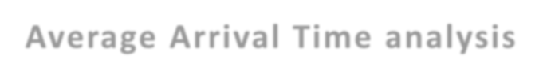
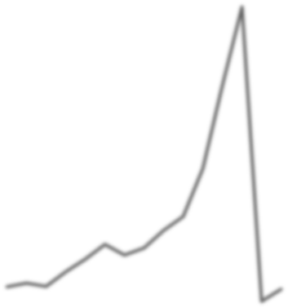

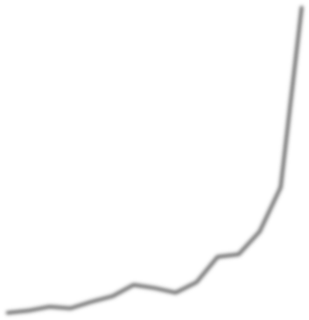
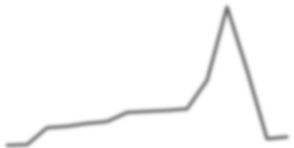




Statistics
Average Arrival Time Analysis
200
180
160
140
120
100
80
60
40
20
0
Cost in Seconds
Optimized Average A.T
Base Case Average A.T
Optimized Average A.T per hour
Base Case Average A.T per hour

Slide 13

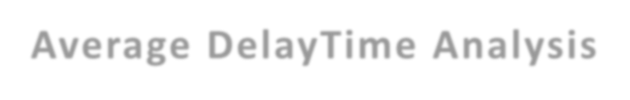
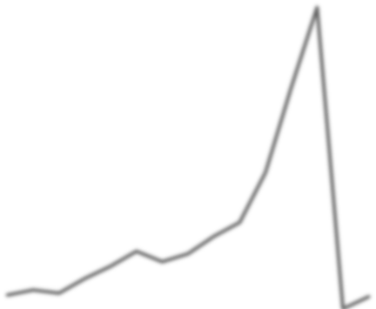
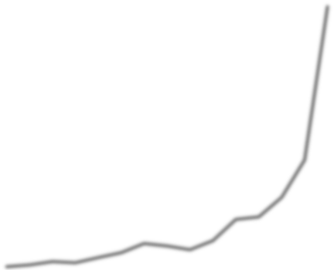
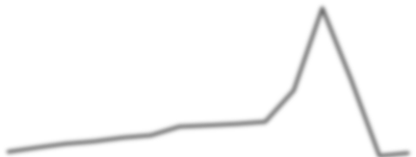
Average Time-Delay Analysis
200
180
160
140
120
100
80
60
40
20
0
Cost in Seconds
1 2 3 4 5 6 7 8 9 10 11 12 13 14 15
Optimized A.T Delay Time (1 train per hour)
Optimized A.T Delay Time (Random #) Base Case A.T Delay Time (1 train per hour)
Base Case A.T Delay Time (Random #)
Passengers

Slide 14

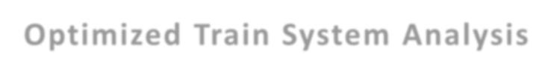

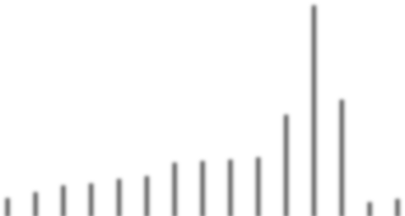
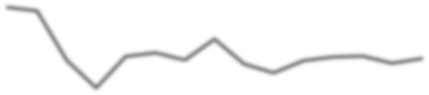

Optimized Train System Analysis
120
700
100
600
500
80
400
60
Cost in Seconds
300
40
200
20
100
0
0
10 20 30 40 50 60 70 80 90 100 200 300 400 500 1000
Average A.T ( 1 train per hour) Average Delay ( 1 train per hour) Average A.T (Random #) Average Delay (Random #)
Average Distance ( 1 Train per hour) Average Distance (Random #)
Speed Visualization Constant
Passengers

Slide 15
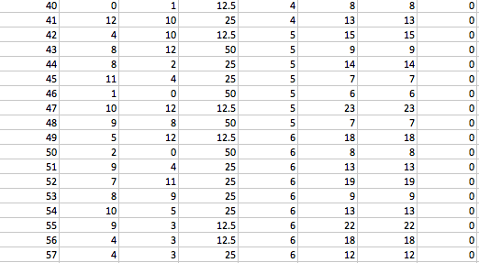
Statistics (Continued)

Slide 16
Limitations
No Animation Representation

Slide 17
Thanks for Listening!

